Slide 1
ELEMENTARY STATISTICS, BLUMAN
Levels of Measurement
© 2019 McGraw-Hill Education. All rights reserved. Authorized only for instructor use in the classroom. No reproduction or further distribution permitted without the prior written consent of McGraw-Hill Education.

Slide 2
Objectives for this PowerPoint
Define and learn to identify
The nominal level of measurement
The ordinal level of measurement
The interval level of measurement
The ratio level of measurement

Slide 3
Definition – Nominal Level
The nominal level of measurement classifies data into mutually exclusive (non-overlapping) categories in which no order or ranking can be imposed on the data.
The cars in a parking lot can be classified according to their color. There might be red, blue, green, or silver cars in the lot. But no ranking or order can be imposed on the variable “color.”
Classifying residents according to zip codes is also an example of the nominal level of measurement. Even though numbers are assigned as zip codes, there is no meaningful order or ranking.

Slide 4
Definition – Ordinal Level
The ordinal level of measurement classifies data into categories that can be ranked; however, precise differences between the ranks do not exist.

Slide 5
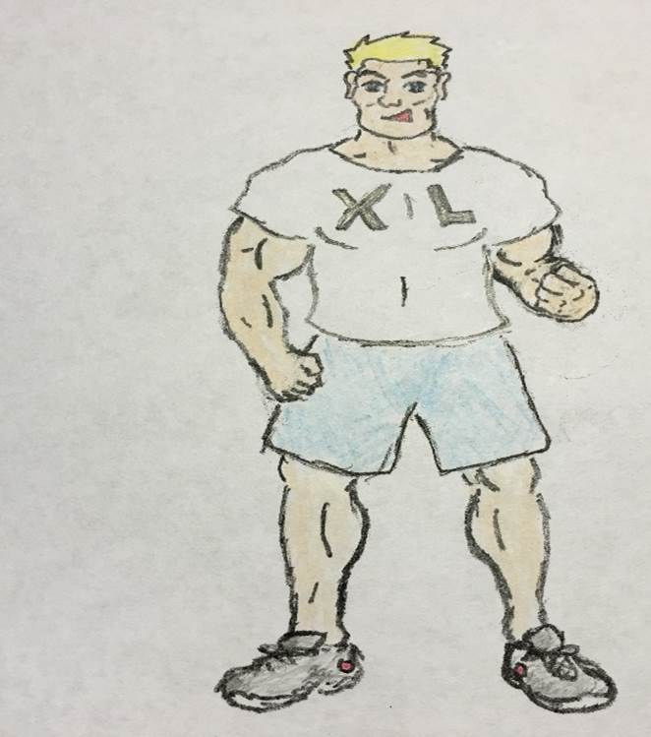
Example - Ordinal Level
T-shirt size is an example of the ordinal level of measurement.

Slide 6
Definition – Interval Level
The interval level of measurement ranks data, and precise differences between units of measure do exist; however, there is no meaningful zero.
IQ is an example of the interval level of measurement. There is a meaningful difference of 1 point between an IQ score of 109 and an IQ score of 110. But there is no meaningful zero to this scale as IQ tests do not measure people who have no intelligence.

Slide 7

Example – Interval Level
Temperature of a jumping frog is another example. There is a meaningful difference of 1˚F between a temperature of 98.6˚F and 99.6˚F. But 0˚F does not imply that the frog has no temperature.

Slide 8
Definition – Ratio Level
The ratio level of measurement possesses all the characteristics of interval measurement, and there exists a true zero. In addition, true ratios exist when the same variable is measured on two different members of the population.
If one person has 200 Instagram followers and another person has 100 followers, then not only is there an interval difference of 100 followers, but we can also state the relationship between them as a ratio of 2 to 1. Stated another way, the first person has twice as many followers as the second person. There is also a meaningful zero. If the value of the variable is zero, it implies that a person has no Instagram followers.

Slide 9
Examples
Classify each of the following according to level of measurement
Points scored by basketball players in a game
Time of day
Birth city for a sample of students
Level of agreement on a survey

Slide 10
Example 1 (1)
Points scored by basketball players in a game
The data values can be ordered
Interval differences exist between the data values
True Ratios exist between data values
There exists a significant zero
10 points is less than 20 points
20 points minus 10 points = 10 points
20 points/10 points = 2 to 1 ratio
Zero points implies that a player did not score

Slide 11
Example 1 (2)
Points scored by basketball players in a game is an example of Ratio Level of Measurement.

Slide 12
Example 2 (1)
Time of day
Data values can be ordered
Interval differences exist between the data values
True ratios do not exist between the data values
There does not exist a true zero
2:30 comes before 5:00
There is a measurable span of 2.5 hours between 2:30 and 5:00
It cannot be stated that 5:00 is twice as late as 2:30
If some requested the time, the reply would never be “zero”

Slide 13
Example 2 (2)
Time of day is an example of Interval Level of Measurement

Slide 14
Example 3 (1)
Birth city for a sample of students
No ranking or order can be placed on the data
Walla Walla, Washington Saskatoon, Saskatchewan
Crapstone, England

Slide 15
Example 3 (2)
Birth city is an example of Nominal Level of Measurement

Slide 16
Example 4 (1)
Level of agreement on a survey
Data can be ranked in order
No interval difference can be measured between the data values
Strongly Disagree, Disagree, Neutral, Agree

Slide 17
Example 4 (2)
Level of agreement on a survey is an example of Ordinal Level of Measurement

Slide 18
Summary
In this PowerPoint we defined nominal level of measurement, ordinal level of measurement, interval level of measurement, and ratio level of measurement.

Slide 19
ELEMENTARY STATISTICS, BLUMAN
Types of Data
© 2019 McGraw-Hill Education. All rights reserved. Authorized only for instructor use in the classroom. No reproduction or further distribution permitted without the prior written consent of McGraw-Hill Education.

Slide 20
Objectives for this PowerPoint
Define and learn to classify variables as
Qualitative variables
Quantitative variables
Discrete variables
Continuous variables

Slide 21
Qualitative Variables
Qualitative Variables are variables that have distinct categories according to some characteristic or attribute.
Examples of qualitative variables
Hair color
Soft drink brand
Jersey number
Although the variable jersey number is numerical. It bears no associated countable or measureable quantity.

Slide 22
Quantitative Variables
Quantitative variables are variables that can be counted or measured.
Examples of quantitative variables
Number of frogs
Distance a frog can jump
Temperature of a frog

Slide 23
Discrete Variables
Discrete variables assume values that can be counted.
Examples of discrete variables
Number of frogs in a jumping contest
Number of basketball goals scored during a game
Number of tomato plants in a garden
This variable can only take on counting numbers like 5, 6, 10, or 1000. It could not take on a value like 5.5, 10.6, or 99.9.

Slide 24
Continuous Variables
Continuous variables can assume an infinite number of values between any two specific values. They are obtained by measuring.
Examples of continuous variables
Distance a frog jumps in a contest
Temperature of a frog
Weight of a frog

Slide 25
Summary
In this PowerPoint we defined qualitative variables, quantitative variables, discrete variables, and continuous variables.

Slide 26
ELEMENTARY STATISTICS, BLUMAN
Sampling Techniques (Part 1 of 2)
© 2019 McGraw-Hill Education. All rights reserved. Authorized only for instructor use in the classroom. No reproduction or further distribution permitted without the prior written consent of McGraw-Hill Education.

Slide 27
Objectives for this PowerPoint
Learn to identify two of the four basic sampling techniques.

Slide 28
Example
Suppose an employee in a polling firm wishes to gage the public attitude towards a specific public policy. Each member of the population could potentially have an opinion about the policy. However, it would be impossible from a time and expense standpoint to poll each member of the population.

Slide 29
Sample of Population
In cases like this where it would be impossible for researchers to gather the data associated with an entire population a subset of the population would be used as a representative. This subset is called a sample.
In order for this sample to be of optimal use to the researcher in making predictions about the population. The sample must be a good representative of the population. This simply means that measures associated with the sample would very likely closely approximate those of the population.

Slide 30
Eliminate Bias
In order to achieve this close approximation established sampling techniques are employed. These sampling techniques are designed to eliminate bias. Information obtained from a statistical sample is said to be biased if the results from the sample are radically different from the results of a census of the population.

Slide 31
Example of Bias
For instance if a pre-election poll suggests that a particular candidate for public office will receive approximately 62% of the vote and then loses the election when his or her opposition receives more than 50% of the vote then the polling results contained bias.

Slide 32
Four Methods of Sampling
In order to eliminate bias, statisticians use four basic methods of sampling that are designed to ensure that each member of a population has an equal probability of being selected for the sample. These four sampling techniques are called
Random Sampling
Systematic Sampling
Stratified Sampling
Cluster Sampling

Slide 33
Random and Systematic Sampling
In this PowerPoint we will focus on Random Sampling and Systematic Sampling.

Slide 34
Random Sample
A random sample is a sample in which each member of the population has an equal probability of being selected.

Slide 35
Random Sample Example
Suppose an executive of a company that employs thousands of people all over the country would like to include her employees in shaping the vision for the future of the company. This would require a considerable amount of time and effort for each employee who is included in the process. Therefore, it would be impossible to include the population in this process. She wishes for the opinions of the included employees to be representative of those of the entire company. She decides that there should be 30 employees on this committee. She coordinates with the human resources office to create a database that assigns a unique number to each of her employees. She then uses a computer program to generate a list of 30 unique random numbers and uses them to select the employees for the committee. Since the numbers were generated randomly, each employee had an equal probability of being selected for the committee.

Slide 36
Systematic Sampling
A systematic sample is a sample obtained by selecting every kth member of the population where k is a counting number.
Where k is a counting number.

Slide 37
Systematic Sample Example
Suppose a bottling company would like to test the machines that are filling the bottles by selecting a sample of filled bottles and measuring the amount of product that the machine is putting in the bottles. The company statistician goes to the end of the bottling line and selects every 20th bottle and removes it for testing. This “system” has thus generated a systematic sample.

Slide 38
Summary
In this PowerPoint we learned how to identify two of the four basic sampling techniques.

Slide 39
ELEMENTARY STATISTICS, BLUMAN
Sampling Techniques (Part 2 of 2)
© 2019 McGraw-Hill Education. All rights reserved. Authorized only for instructor use in the classroom. No reproduction or further distribution permitted without the prior written consent of McGraw-Hill Education.

Slide 40
Objectives for this PowerPoint
Learn to identify two of the four basic sampling techniques.

Slide 41
Four Methods of Sampling
In order to eliminate bias, statisticians use four basic methods of sampling that are designed to ensure that each member of a population has an equal probability of being selected for the sample. These four sampling techniques are called:
Random Sampling
Systematic Sampling
Stratified Sampling
Cluster Sampling

Slide 42
Focus on Stratified and Cluster Sampling
In this PowerPoint we will focus on Stratified Sampling and Cluster Sampling.

Slide 43
Stratified Sampling
A stratified sample is obtained by dividing the population into subgroups or strata according to some characteristic relevant to the study. Then subjects are selected from each subgroup.

Slide 44
Example of Stratified Sampling
Suppose a marketing executive is testing a product and measuring the sales potential within age groups. Opinions are gathered from people who fall into the following age groups:
18 to 29
30 to 41
42 to 53
54 to 65
66 and older
The data can then be used to determine the sales potential within each group.

Slide 45
Cluster Sample
A cluster sample is obtained by dividing the population into sections or clusters and then selecting one or more clusters and using all members in the clusters as members of the sample.

Slide 46
Example of a Cluster Sample
Suppose the governor of a state would like to find out what the citizens think about a certain budgetary item that will require extra taxation. He is also concerned with the opinions of those who live in the western part of the state, the central part, and the eastern part. The governor will randomly select citizens from each part of the state to see if there are differences of opinion between the regions.

Slide 47
Summary
In this PowerPoint we learned to identify two of the four basic sampling techniques

Slide 48
ELEMENTARY STATISTICS, BLUMAN
Experimental Design
© 2019 McGraw-Hill Education. All rights reserved. Authorized only for instructor use in the classroom. No reproduction or further distribution permitted without the prior written consent of McGraw-Hill Education.

Slide 49
Objectives for this PowerPoint
Recognize, and understand the advantages and disadvantages of, an observational study.
Recognize, and understand the advantages and disadvantages of, an experimental study.

Slide 50
Observational Study
The researcher merely observes what is happening or what has happened in the past and tries to draw conclusions based on these observations.

Slide 51
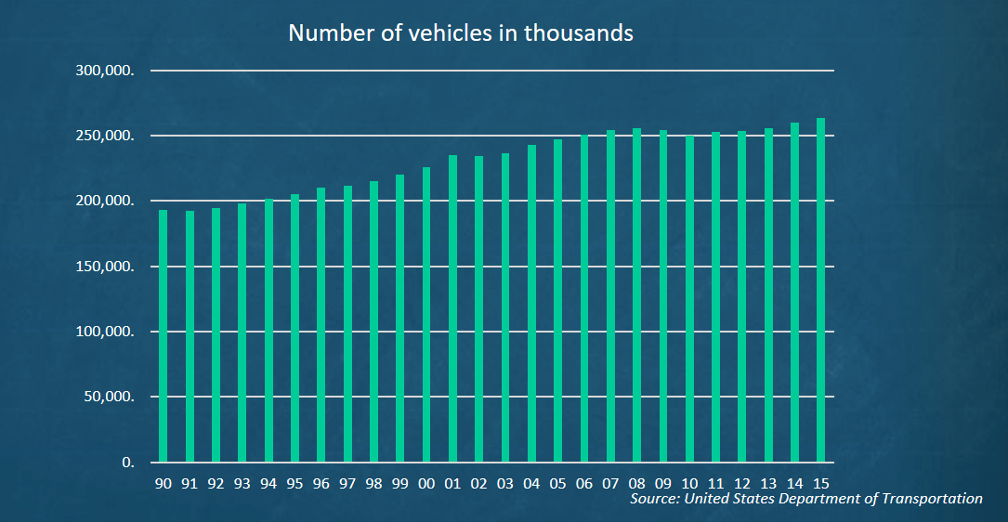
Example of Observational Study
If a researcher looks at the number of registered vehicles in the US from the years 1990 through 2015. Then the researcher is merely looking at a historical data set. There is no intervention by the researcher in the process of gathering and reporting this data.

Slide 52
Advantages of Observational Study
Observational studies are typically carried out in a natural setting.
Observational studies can be carried out in situations where intervention by the researcher would be considered unethical or even dangerous such as in the case of crime statistics.
Observational studies can be done using variables where manipulation is impossible such as studies involving height, age, and race.

Slide 53
Disadvantages of Observational Study
A definite cause and effect relationship cannot be shown since the researcher cannot manipulate other influencing variables.
The research is subject to the inaccuracies of other data gatherers such as in the case of historical data like crime statistics from the 1800s or health statistics from another country.

Slide 54
Experimental Study
The researcher manipulates one of the variables and tries to determine how the manipulation influences other variables.

Slide 55
Example of Experimental Study
When a pharmaceutical company tests the side effects for experimental medications they will administer a placebo to a control group and the actual medical therapy to the treatment group. They would then compare to see if a statistical significance exists between the incidents of a side effect between the two groups.
 | Control Group | Treatment Group
Cranial Diminution | 2.2% | 5.3%
Digital Curvature | 3.8% | 4.2%

Slide 56
Advantages of Experimental Study
The researcher can decide how to select subjects and assign them to groups such as control and treatment groups.
The researcher can manipulate variables such as dosages in medical studies.

Slide 57
Summary
In this PowerPoint we learned the following:
Recognize, and understand the advantages and disadvantages of, an observational study.
Recognize, and understand the advantages and disadvantages of, an experimental study.

Slide 58
ELEMENTARY STATISTICS, BLUMAN
Misuses of Data
© 2019 McGraw-Hill Education. All rights reserved. Authorized only for instructor use in the classroom. No reproduction or further distribution permitted without the prior written consent of McGraw-Hill Education.

Slide 59
Objectives for this PowerPoint
Identify and avoid the following ways that data is misused to create a false impression:
Suspect Samples
Ambiguous Averages
Changing the Subject
Detached Statistics
Implied Connections
Misleading Graphs

Slide 60
Data
Data is used appropriately every day to attempt to describe populations, compare populations, determine relationships between variables, test hypotheses, and make estimates about population characteristics.
However, data is also frequently misused to sell products that don’t work properly, to attempt to prove something true that is not really true, or to get our attention by using statistics to evoke fear, shock, and outrage.

Slide 61
Suspect Samples (1)
It is important that sample sizes are large enough, and that the subjects in the sample were selected randomly.
Consider the statement “3 out of 4 doctors recommend pain reliever A”. If the sample contained only 4 doctors, then the data set is certainly not large enough to draw a significant conclusion. A sample size of 100 doctors might suggest more reliable results.
A sample size of 100 doctors might suggest more reliable results. However, if the 100 doctors in the survey were selected conveniently at a conference sponsored by Pain Reliever A, then the results might suggest some bias that would render the results unreliable.

Slide 62
Suspect Samples (2)
It is important that sample sizes are large enough, and that the subjects in the sample were selected randomly.
If new media outlets relied on samples taken at elementary schools for election polling, your favorite super hero could very well be mistakenly reported as the front runner for the presidential election.

Slide 63
Ambiguous Averages (1)
There are four commonly used measures that are loosely called averages
Mean
Median
Mode
Midrange

Slide 64
Ambiguous Averages (2)
A reporter of statistics, in an attempt to convince his reader to see his point of view, may use the mean to describe a data set that contains a few extreme data values when the median might be a much better descriptor of the central tendencies of the population.

Slide 65
Ambiguous Averages (3)
Consider the following closing prices for all 10 homes sold in a given month in a small town.
A quick examination of the data, shows that homes in this area frequently sell in the mid $100,000 of dollars.
However, we can see that there are more expensive properties that sell in this market as well.
Closing Price
$135k | $147k | $158k | $167k | $450k
$142k | $153k | $159k | $168k | $675k
Mean = $235,400
Median = $158,500

Slide 66
Ambiguous Averages (4)
If the individual data values were unavailable and someone attempted to characterize the data set by reporting only the mean of $235,400.
It would create a false impression with regard to the actual housing market in this town.
The median closing price is $158,500, which is much more representative of the actual housing market in this town.
As you progress through the study of statistics you’ll find that the median is frequently the better measure to characterize data sets that contain extreme data values.

Slide 67
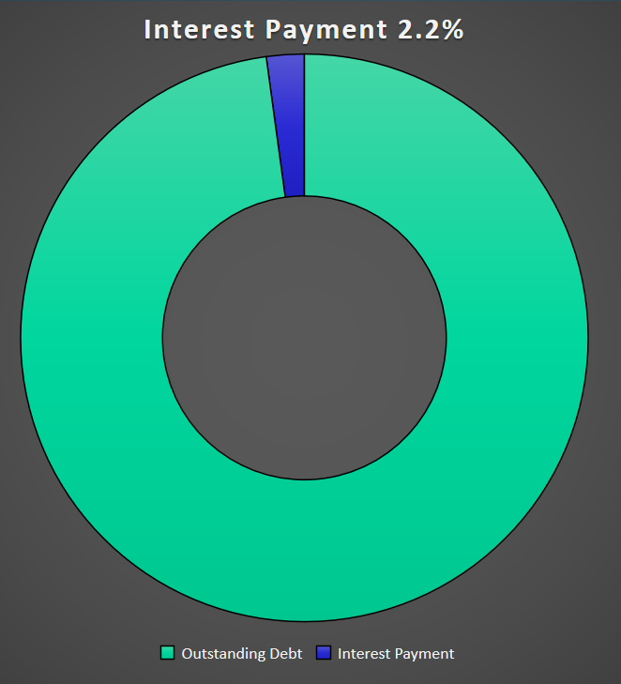
Changing the Subject (1)
Statistical distortion can occur when different values are used to represent the same data.

Slide 68
Changing the Subject (2)
One politician trying to make his point might make the following statement:
The interest payment on outstanding debt for the US Government in 2015 was about 2.2% of the outstanding debt.

Slide 69
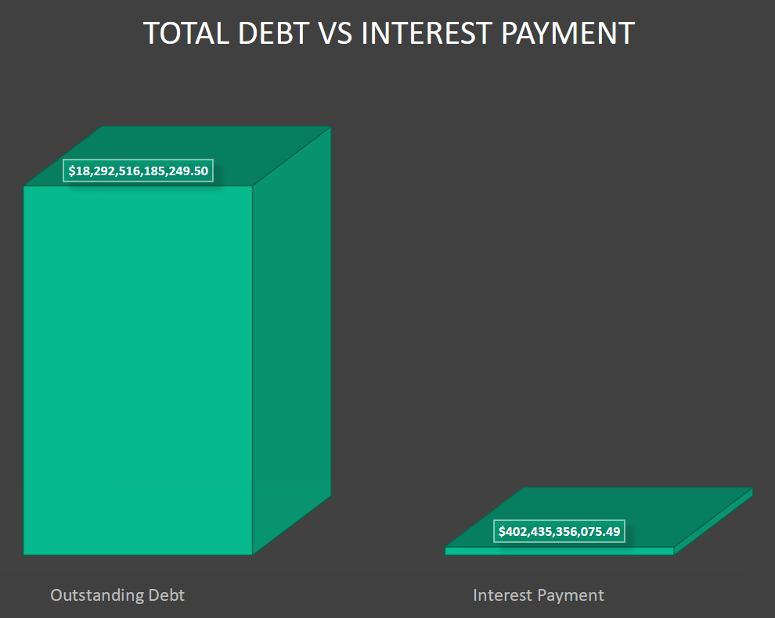
Changing the Subject (3)
Statistical distortion can occur when different values are used to represent the same data.

Slide 70
Changing the Subject (4)
Another politician might attempt to make his point with the following statement:
The interest payment on outstanding debt for the US Government in 2015 was about $402,435,3556,075.49
While both figures represent the same debt payment, using a value like 2.2% to represent such a large number is certainly misleading.

Slide 71
Detached Statistics
A claim that uses a detached statistic is one in which no comparison is made.
Consider the statement:
People who use this diet lose an average of 10 more pounds per day.
No comparison is provided so the question that should be asked is: 10 more pounds per day than what?

Slide 72
Implied Connections
A claim might attempt to imply connections between 2 variables where no connection actually exists.
The advertising claim “Eating one bowl of our oatmeal cereal every morning may improve your child’s ability to focus at school” does not specifically guarantee an increase in academic performance. But the benefit is certainly implied.

Slide 73
Misleading Graphs (1)
Graphs that are inappropriately drawn can lead a reader to draw false conclusions.
Compare the two graphs on the next slide that are intended to represent the results from the same preference survey.

Slide 74
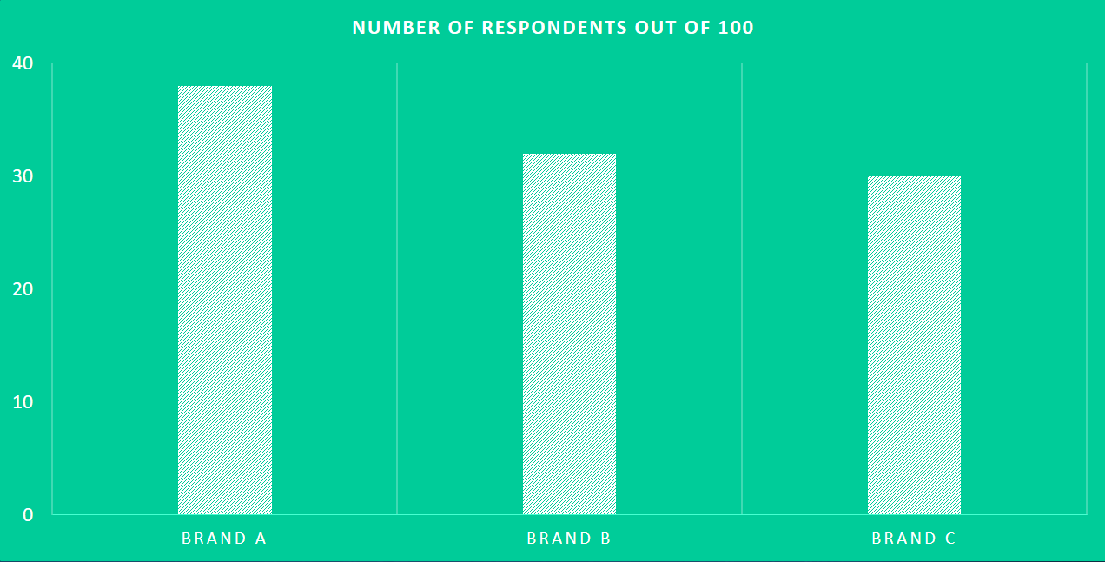
Misleading Graphs (2)

Slide 75
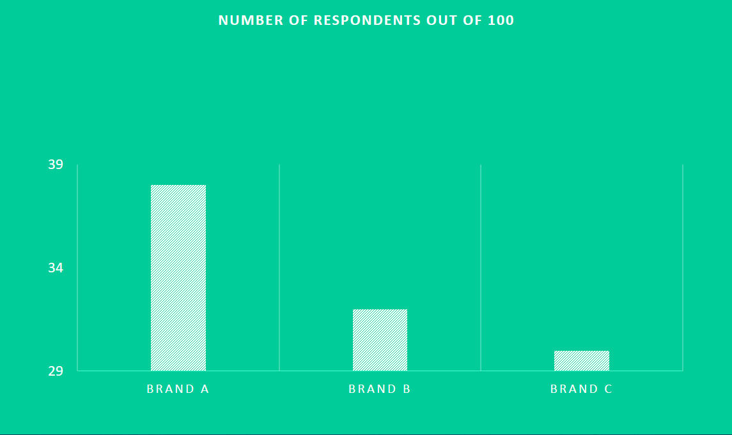
Misleading Graphs (3)

Slide 76
Misleading Graphs (4)
Note that the graph on the right, the y-axis starts at 29 rather than 0 as with the graph on the left.
Note that the graph on the right implies that the preference for brand A is many times the preference for brands B and C.
By starting the y-axis at 0, the graph on the left demonstrates the true proportional relationship between the categories in the data set.

Slide 77
Summary
Identify and avoid the following ways that data is misused
Suspect Samples
Ambiguous Averages
Changing the Subject
Detached Statistics
Implied Connections
Misleading Graphs

Slide 78
ELEMENTARY STATISTICS, BLUMAN
Getting Started with the TI Graphing Calculator
© 2019 McGraw-Hill Education. All rights reserved. Authorized only for instructor use in the classroom. No reproduction or further distribution permitted without the prior written consent of McGraw-Hill Education.

Slide 79
Objectives for this PowerPoint
Turn the TI Graphing Calculator on and off
How to clear a list
How to enter a data set into a list
Sort a list

Slide 80
Giraffe Data
142
143
140
147
117
120
140
120
141
144
127
150
127
137
112
The data table to the right contains the birth weights for 15 giraffes. The data are given in pounds.

Slide 81
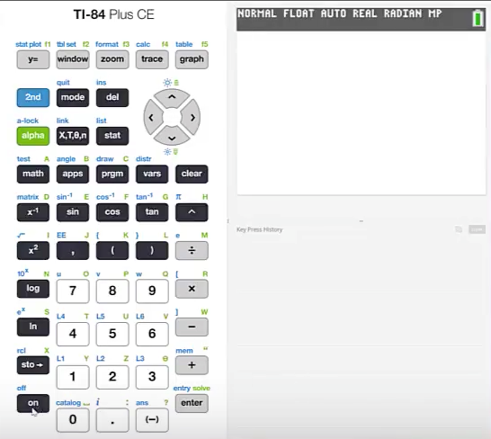
Turn On
In order to turn the TI graphing calculator on press the on button.

Slide 82
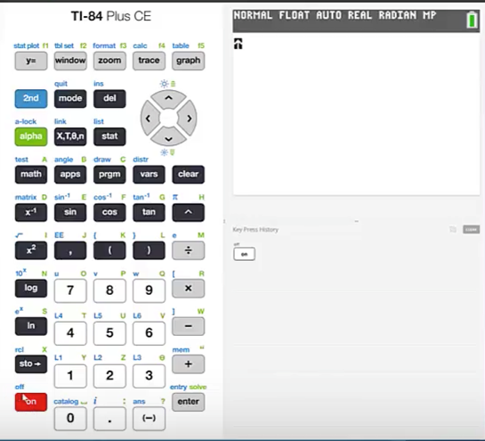
Turn Off
We see that off is printed in blue above the on button.
In order to access the functions that are printed in blue we should first press the 2nd button.
By pressing 2nd and then the on button it will turn the calculator off.

Slide 83
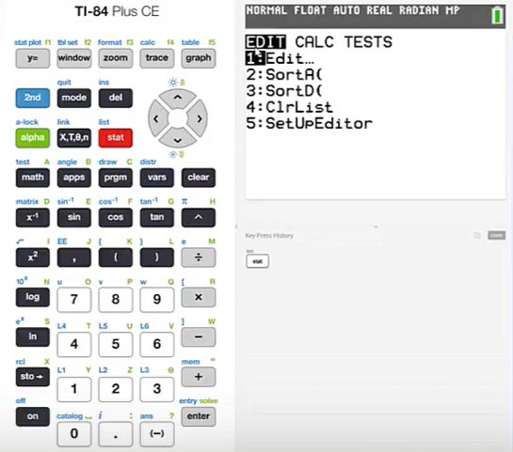
Access a List
To access a list we should first press stat
The first menu in stat is the Edit menu
This is the one that we will use to enter a list. Edit is the first selection and is assigned to the button labeled 1:Edit…
Press 1

Slide 84
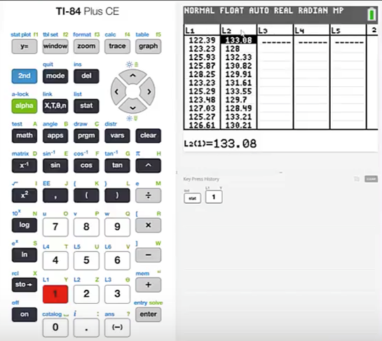
Clear a List (1)
We can see here that there are 5 lists presented. The first 2 lists already contain data.
Let's see how to clear these lists.

Slide 85
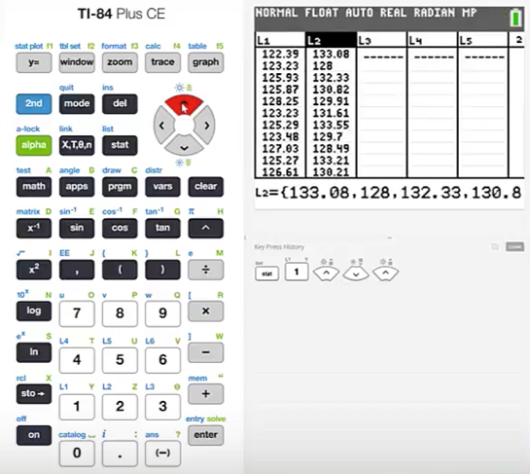
Clear a List (2)
Press the up cursor until a list heading is highlighted.
Press clear
Press enter

Slide 86
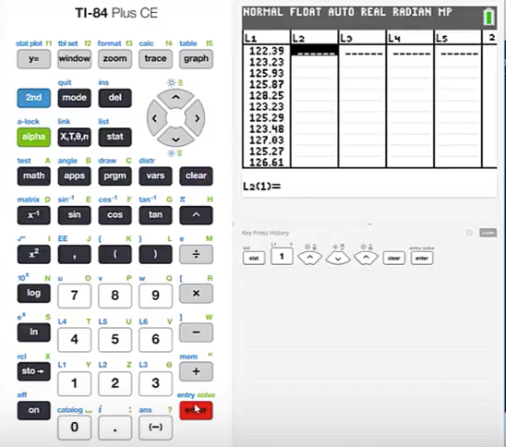
Clear a List (3)
This will clear the entire list.

Slide 87
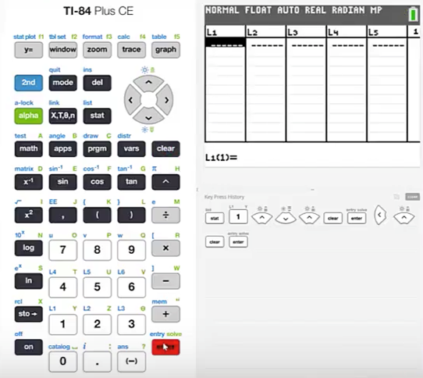
Clear a List (4)
Use the left cursor to highlight the list to the left
Press the up cursor to highlight the heading for List 1
Press clear
Press enter

Slide 88
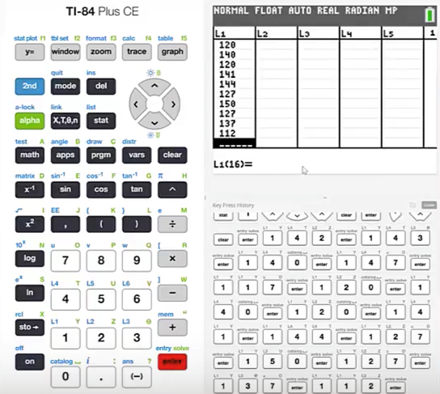
Enter Values in a List
We will now enter the values in the data set for the 15 giraffes.
In order to enter data all we have to do is type in the value.
The first is 142 and then press enter.
This moves the cursor to the next position in the list and then continue to enter all of the data values.

Slide 89
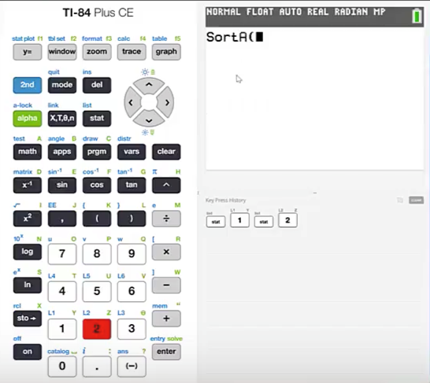
Sort a List (1)
How to Sort a List
In order to sort List 1 we should begin by pressing stat.
The function sort Ascending is assigned to the 2 button. The function sort Descending is assigned to the 3 button. Let's sort the data in an ascending format.
Press 2

Slide 90
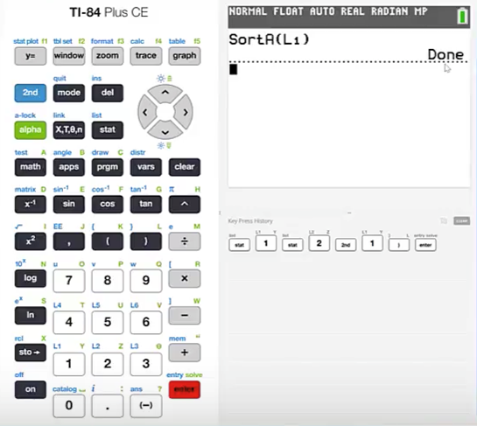
Sort a List (2)
We are prompted to inform the calculator which list should be sorted.
We can see that the blue label above the 1 button is L1 which stands for List 1.
Since it is a 2nd function of the 1 button we'll begin by pressing 2nd and then 1.
Close the parentheses and press enter.
We are notified then that this function is done.

Slide 91
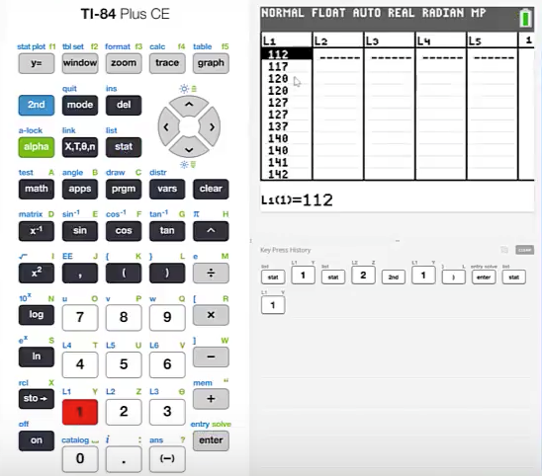
Sort a List (3)
We can see our ascended list by pressing stat and then 1 again for edit.
This data set has been sorted in an ascending format.
By pressing the down cursor we can access each of the entries.

Slide 92
Summary
In this PowerPoint we learned:
How to turn the TI graphing calculator on and off
How to clear a list
How to enter a data set into a list
How to sort a list

